Slide 1
Data import and cleaning with R
Thomas Keller

Slide 2
Modern R makes life easy via tidyverse
Install packages with install.packages
Install.packages(‘tidyverse’) #will install a collection of useful packages, good starting point
Readxl, summarytools are other packages to look at for cleaning functionality

Slide 3
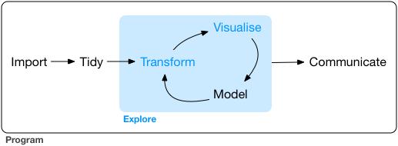
Data life cycle

Slide 4
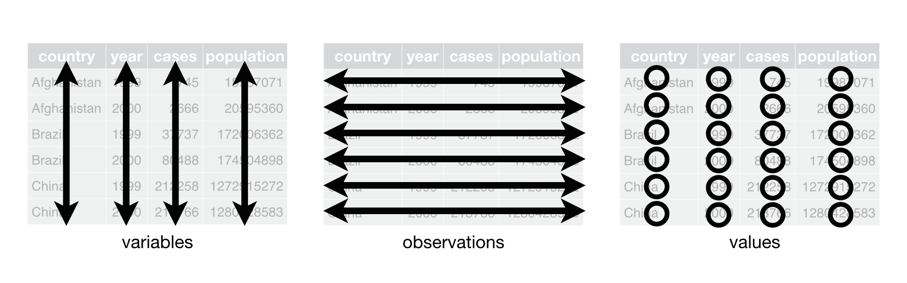
The goal of the tidyverse & cleaning- tidy data

Slide 5
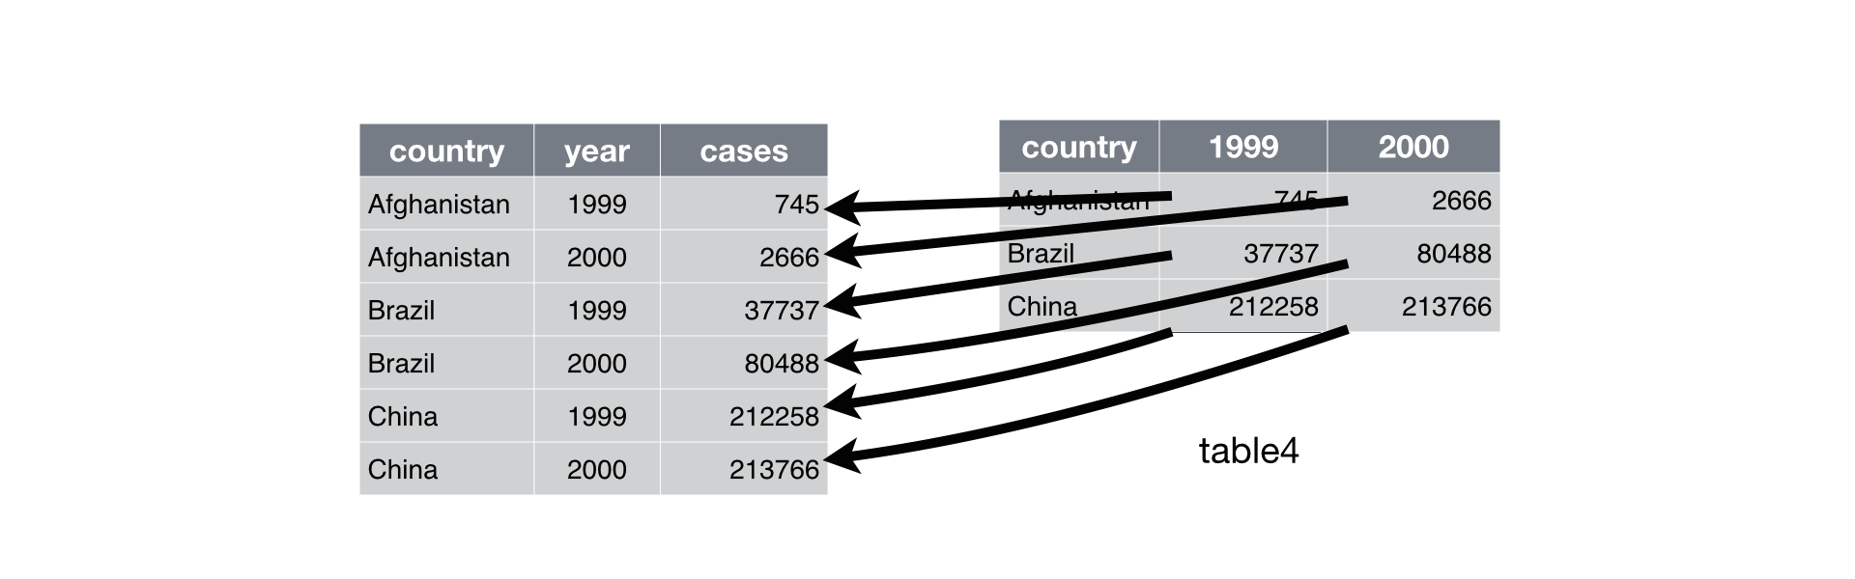
Gathering collapses data from multiple rows into one column

Slide 6
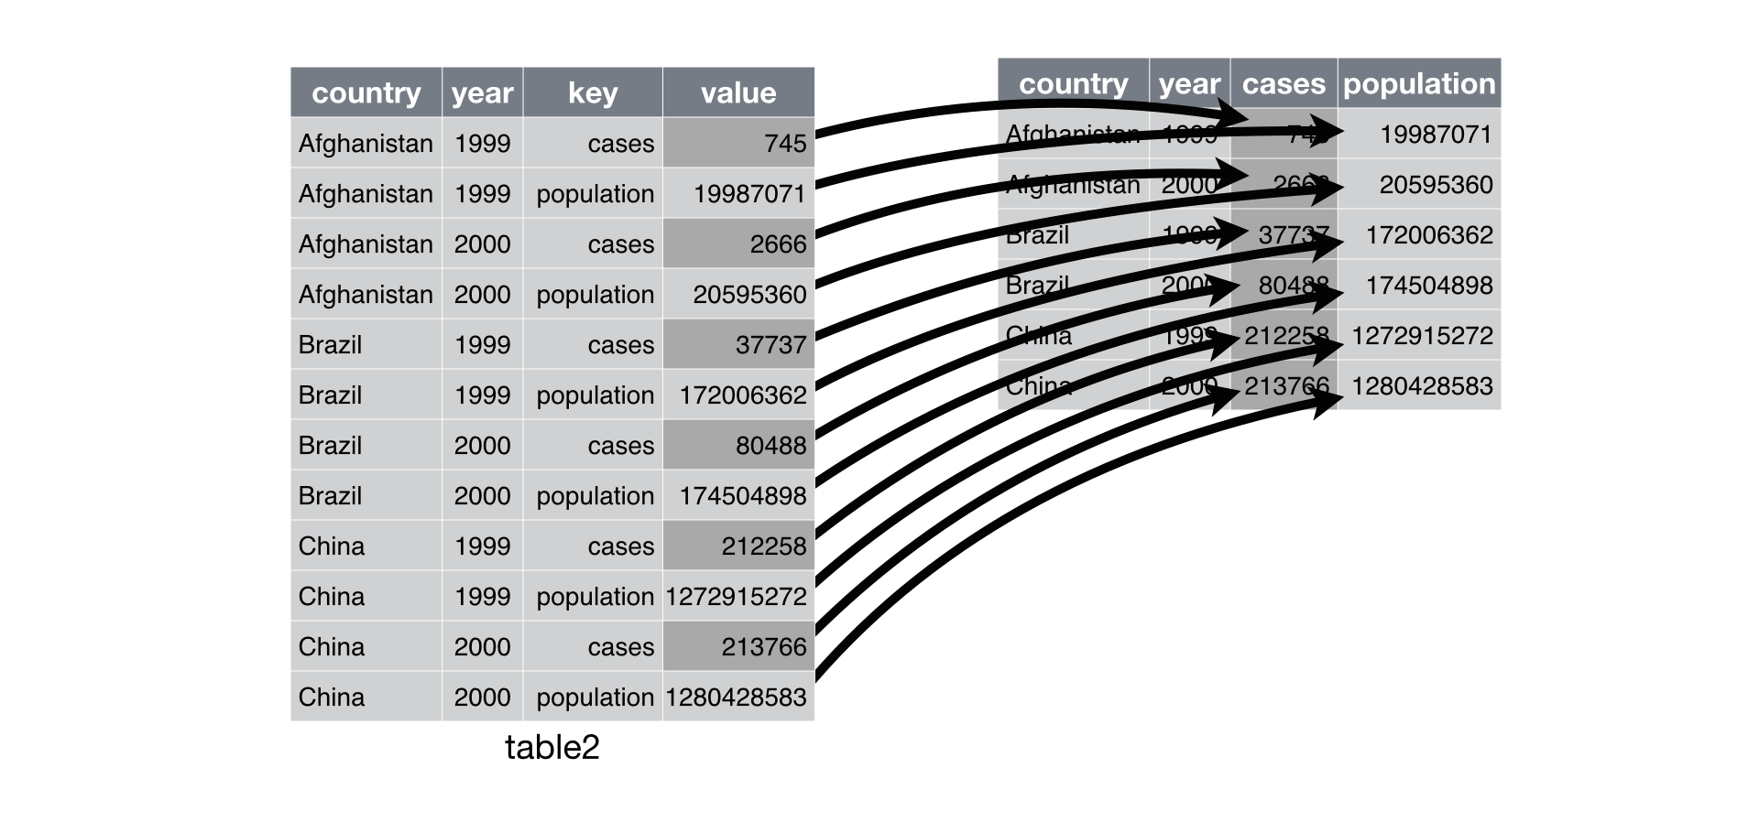
Spread() is the reverse operation

Slide 7
Dplyr – the 5 verbs for cleaning
Select() – select columns
Filter() select rows
Arrange() reorder rows (desc(var) for reverse))
Mutate() create new columns
Summarise() summarise values
Group_by() used with summarise and other verbs for group operations

